Slide 1

Knowledge 2

Slide 2
Resolution 归结原理

Slide 3
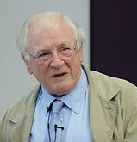
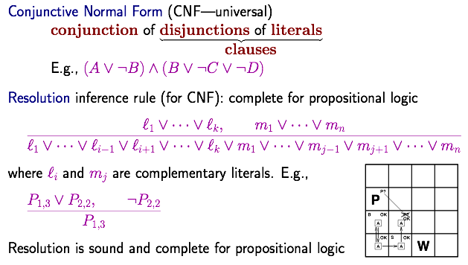
Resolution （消解、归结）
John Alan Robinson
J. A. Robinson. A machine-oriented logic based on the resolution principle. Journal of the ACM, 1965, 12(1):23-41

Slide 4
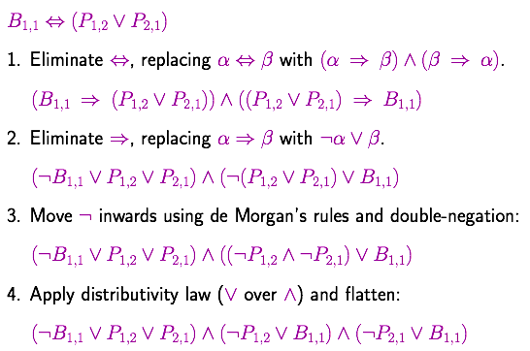
Conversion to CNF
多项式时间复杂度

Slide 5
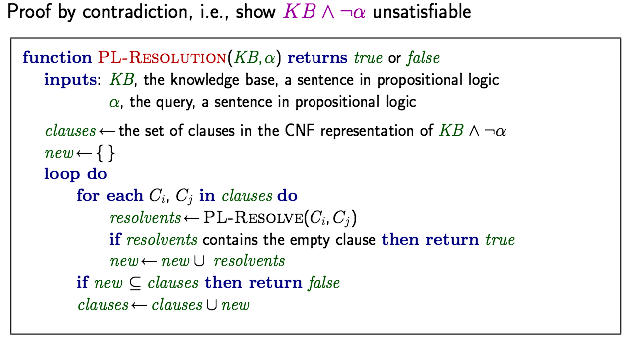
Resolution algorithm

Slide 6
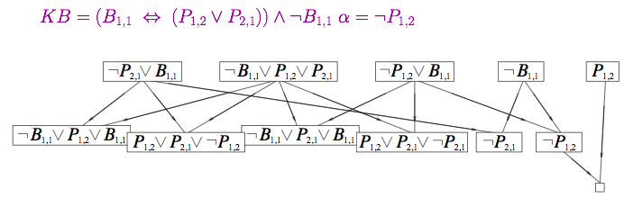
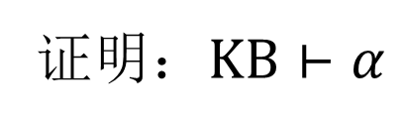
Resolution example
证明：$KB⊢α$

Slide 7
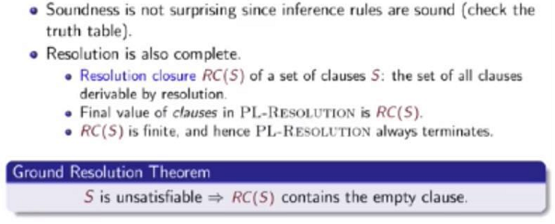
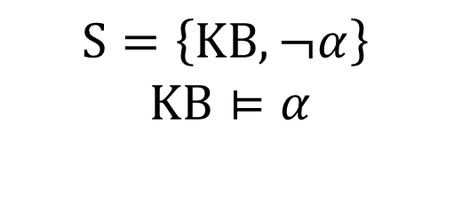
Resolution is Sound and Complete
$$S=\left\{KB, ¬α\right\}$$
$$KB⊨α$$
Notes:
分两种情况，KB是可满足或不可满足

Slide 8
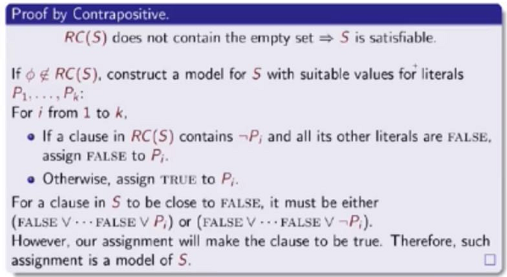
Ground resolution theorem
atomic propositions
证明：这样的truth assignment使得S是可满足的；反证
对于任意的一个子句（肯定是非空子句），当它的文字被指派完的前一步，出现如此的情形。
视频6.5

Slide 9
Process of Resolution: Search
Path-based Search: goal, actions
Requirement: optimal solution in terms of the number of resolution steps
Homework: design a heuristic for A* search
Requirements: formally define what actions are (single clause or a set of clauses (preferred))

Slide 10
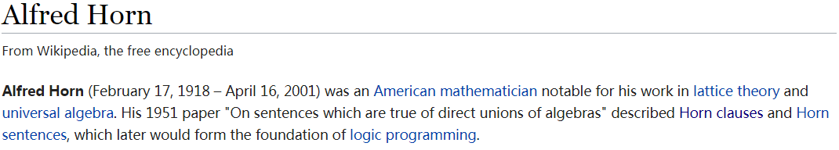
Horn and Definite Clauses
https://en.wikipedia.org/wiki/Alfred_Horn

Slide 11
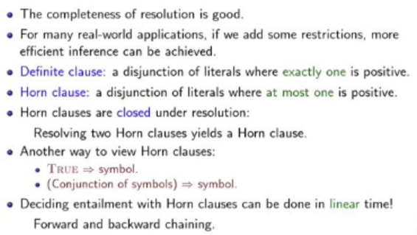
Horn and Definite Clauses
缩小propositional logic的表达范围，以换取更好的inference的时间效率

Slide 12
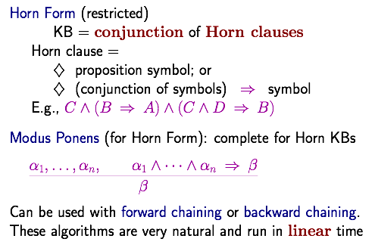
Forward and backward chaining
（肯定式推理）
归结的一种形式

Slide 13
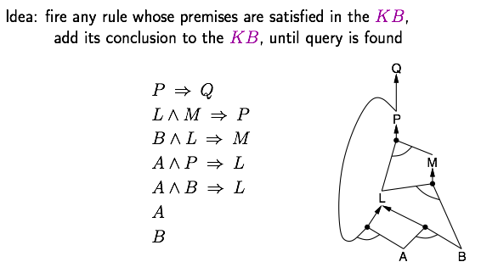
Forward chaining （前向推理）

Slide 14
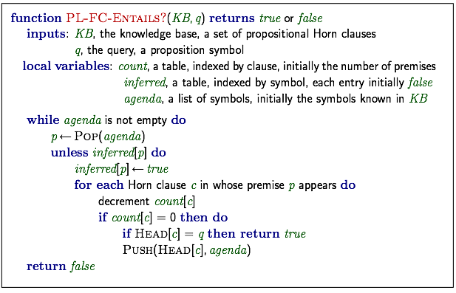
Forward chaining algorithm

Slide 15
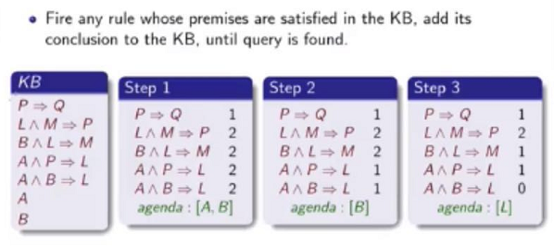
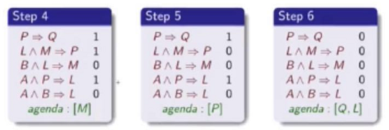
Forward chaining example
Linear to the number of what?

Slide 16
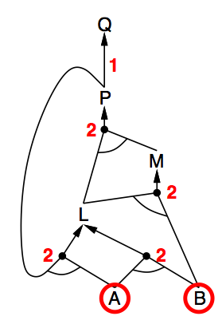
Forward chaining example

Slide 17
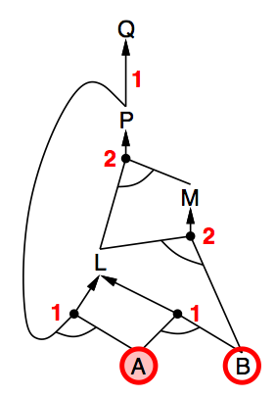
Forward chaining example

Slide 18
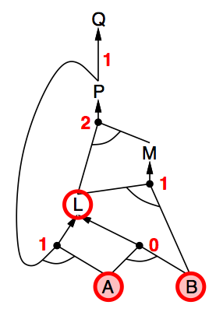
Forward chaining example

Slide 19
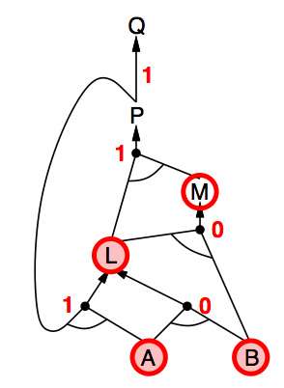
Forward chaining example

Slide 20
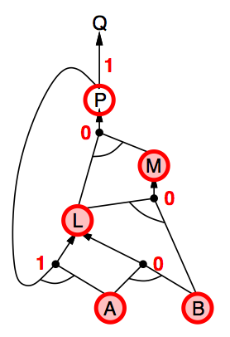
Forward chaining example

Slide 21
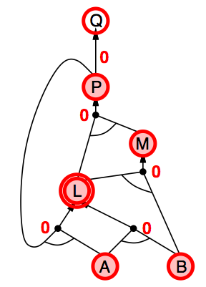
Forward chaining example

Slide 22
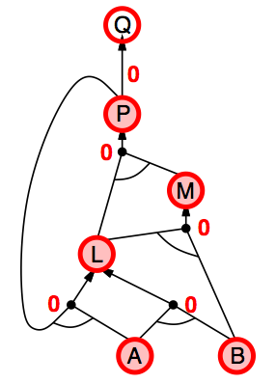
Forward chaining example

Slide 23
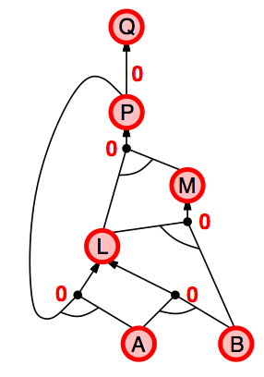
Forward chaining example

Slide 24
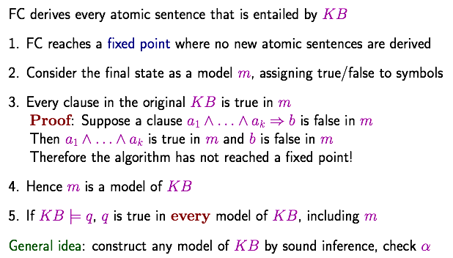
Proof of completeness
Assign TRUE to every symbol inferred and FALSE to others
Consider Bullet 2.

Slide 25
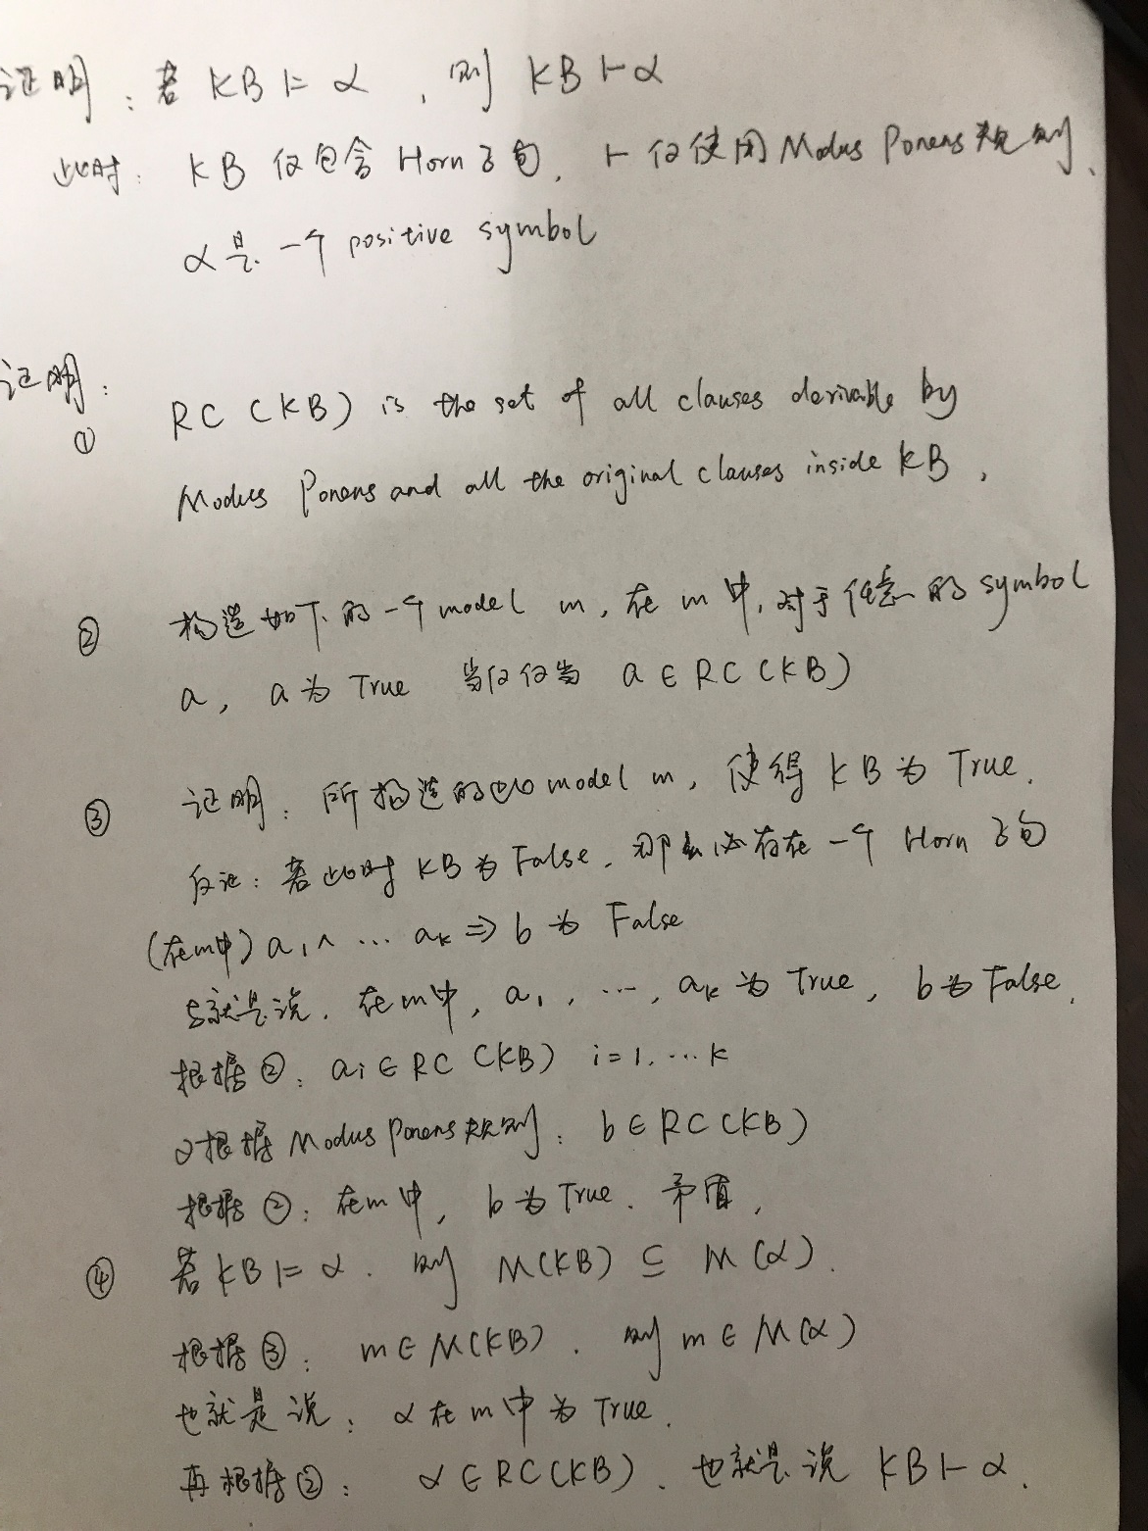
Proof of completeness

Slide 26
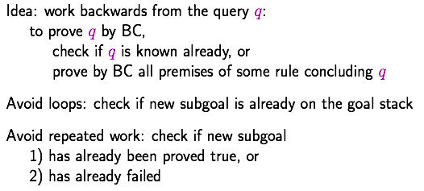
Backward chaining（后向推理）

Slide 27
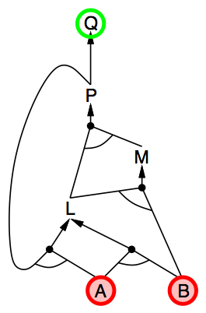
Backward chaining example

Slide 28
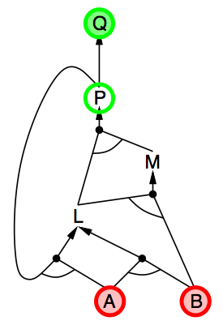
Backward chaining example

Slide 29
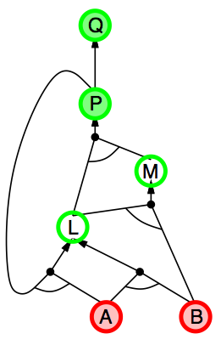
Backward chaining example

Slide 30
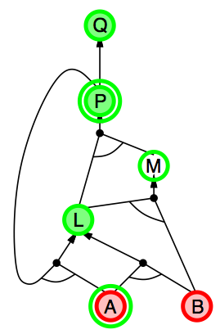
Backward chaining example

Slide 31
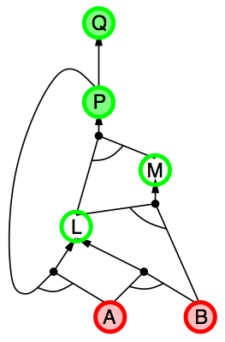
Backward chaining example

Slide 32
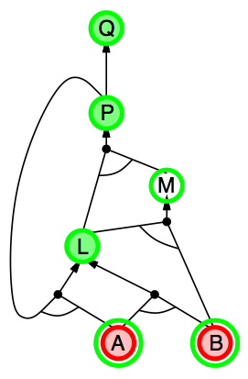
Backward chaining example

Slide 33
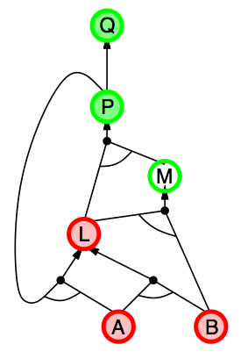
Backward chaining example

Slide 34
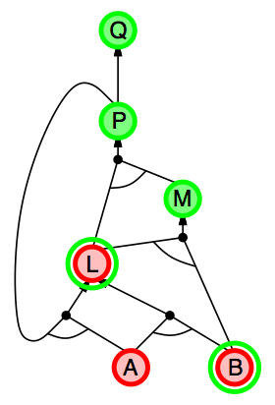
Backward chaining example

Slide 35
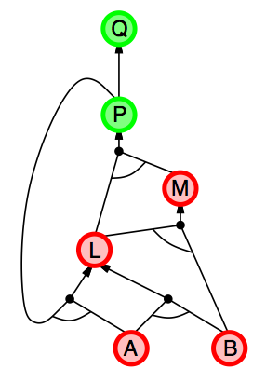
Backward chaining example

Slide 36
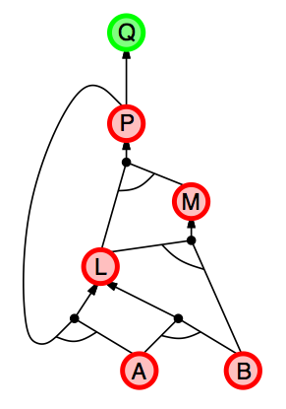
Backward chaining example

Slide 37
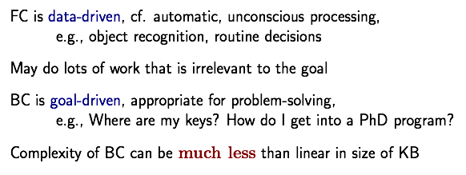
Comparison

Slide 38
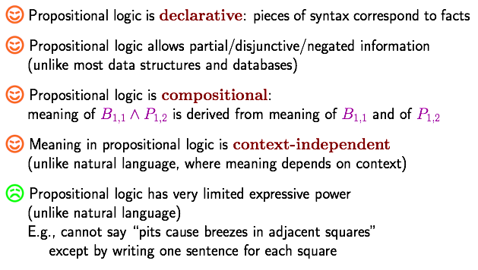
Pros and Cons of Propositional Logic

Slide 39
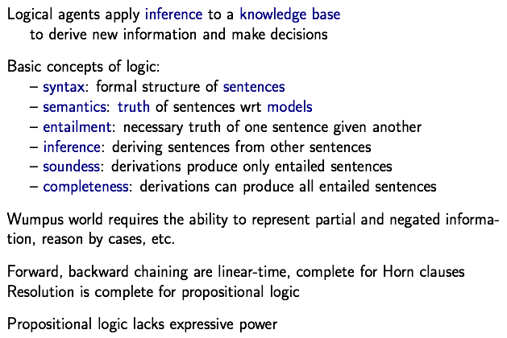
Summary

Slide 40
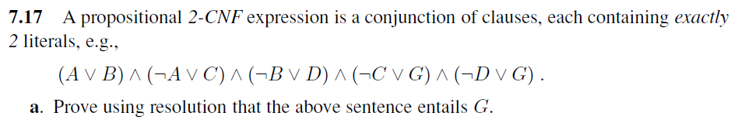
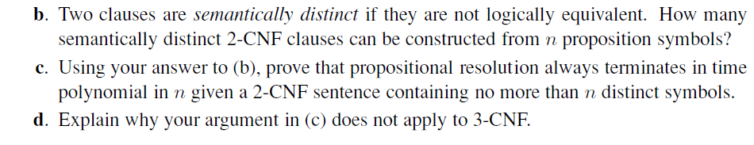
Homework

